Slide 1
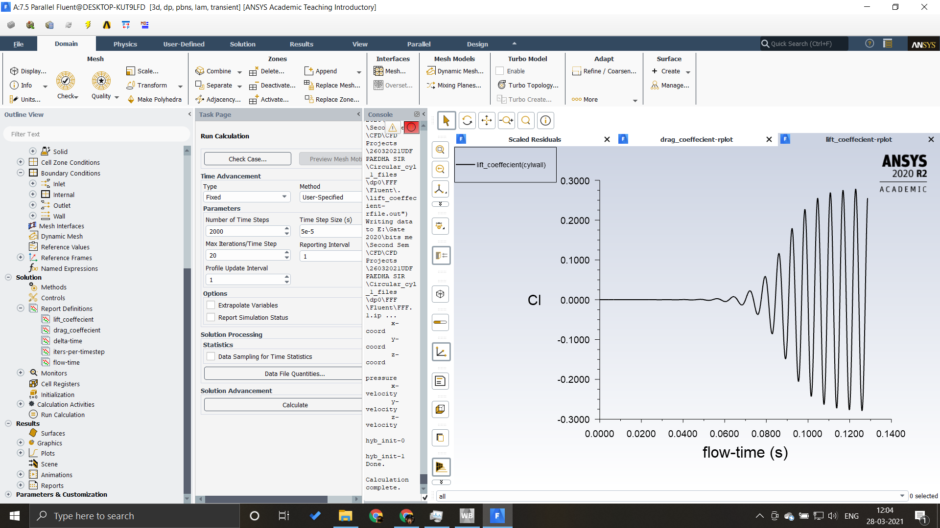
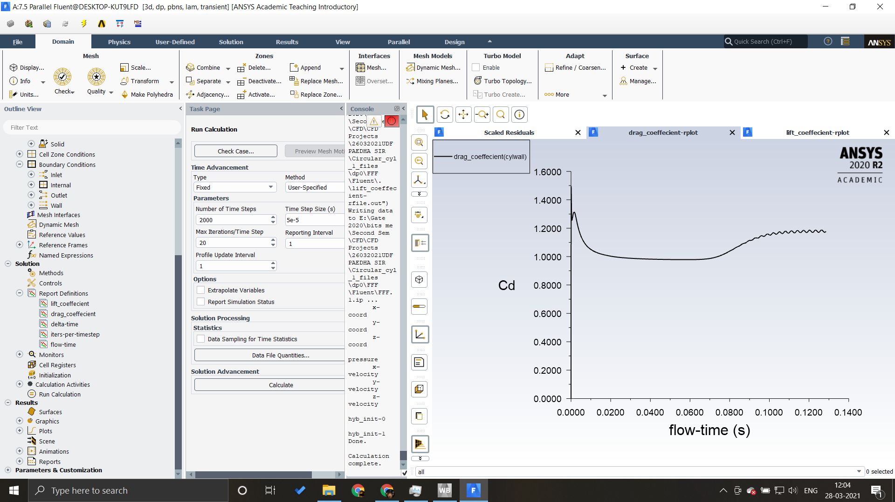
Case 1 : Domain thickness 25mm and Free Stream at top & bottom plates

Slide 2
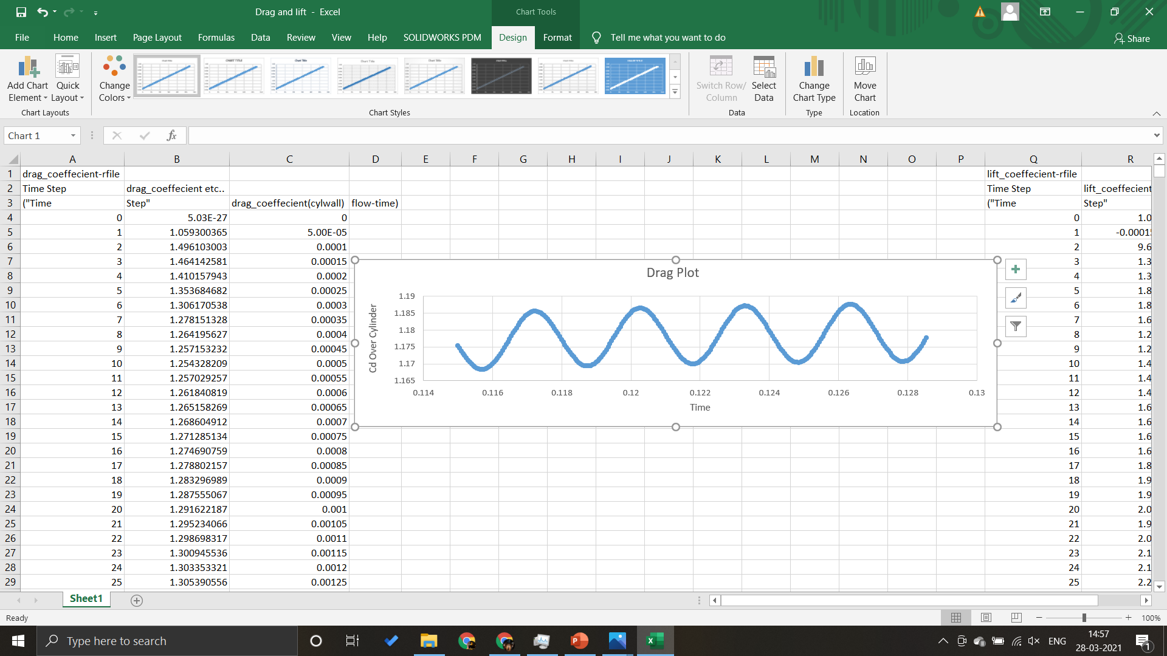
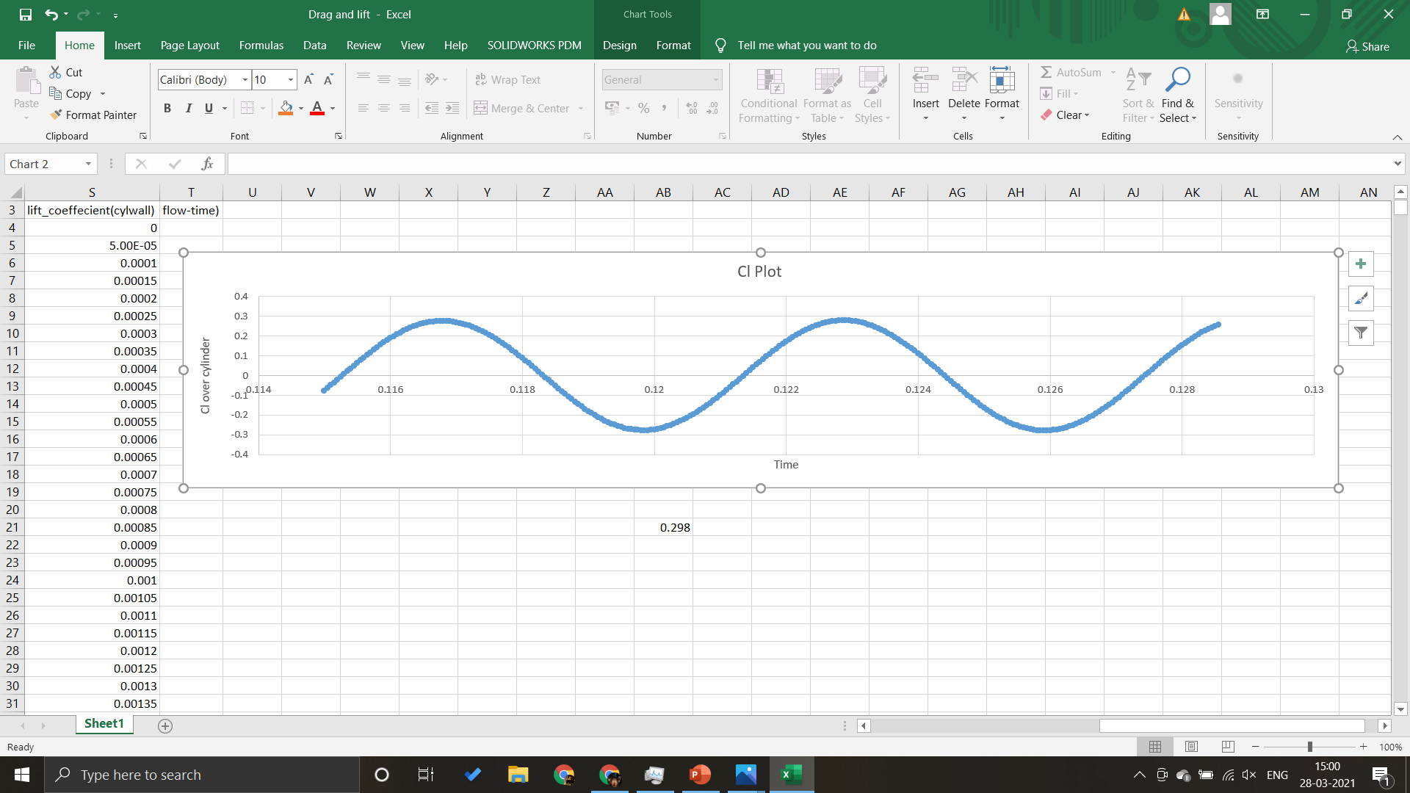
Extracted DATA:
Cd max → 1.188
Cd min → 1.168
Cl max → 0.296
Cl min → -0.296
Cl rms → 0.298

Slide 3
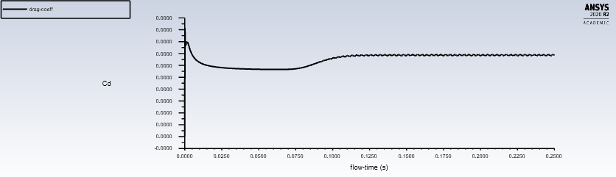
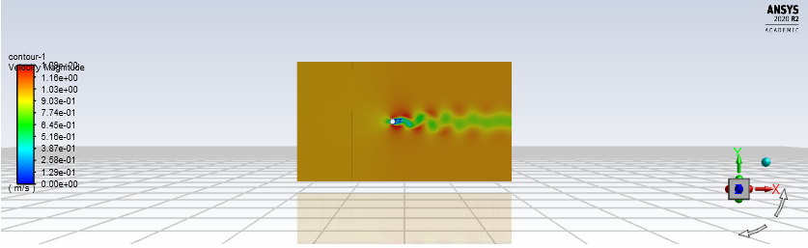
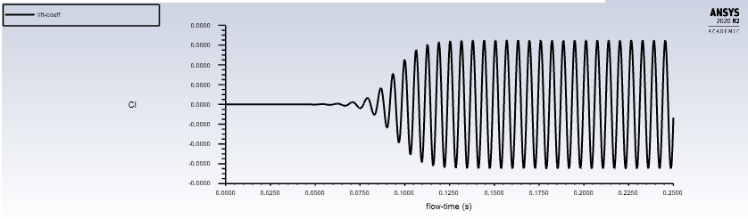
Case 2 : Domain thickness 25mm and No Shear at top & bottom plates

Slide 4
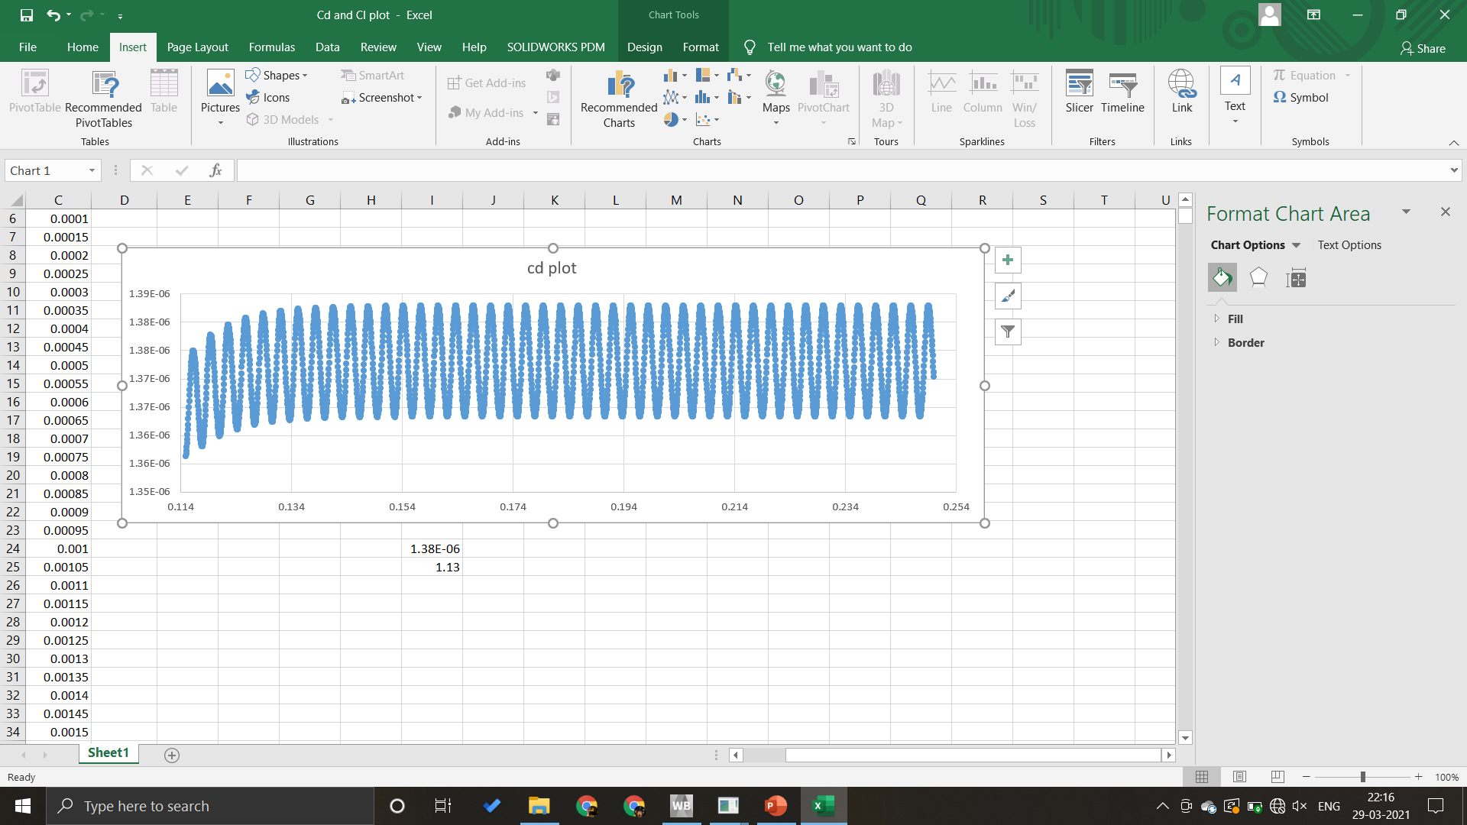
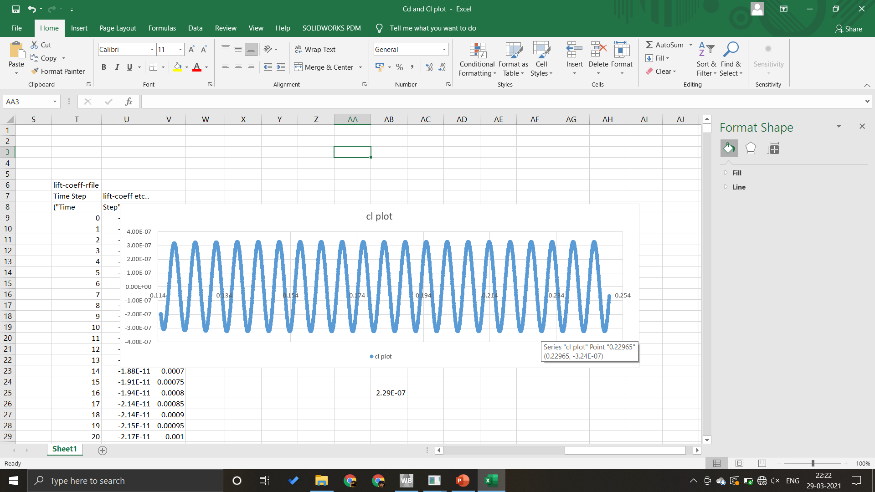
Extracted Data:
Cd max →1.38
Cd min →1.36
Cl max →0.301
Cl min → -0.301
Cl rms → 0.229

Slide 5
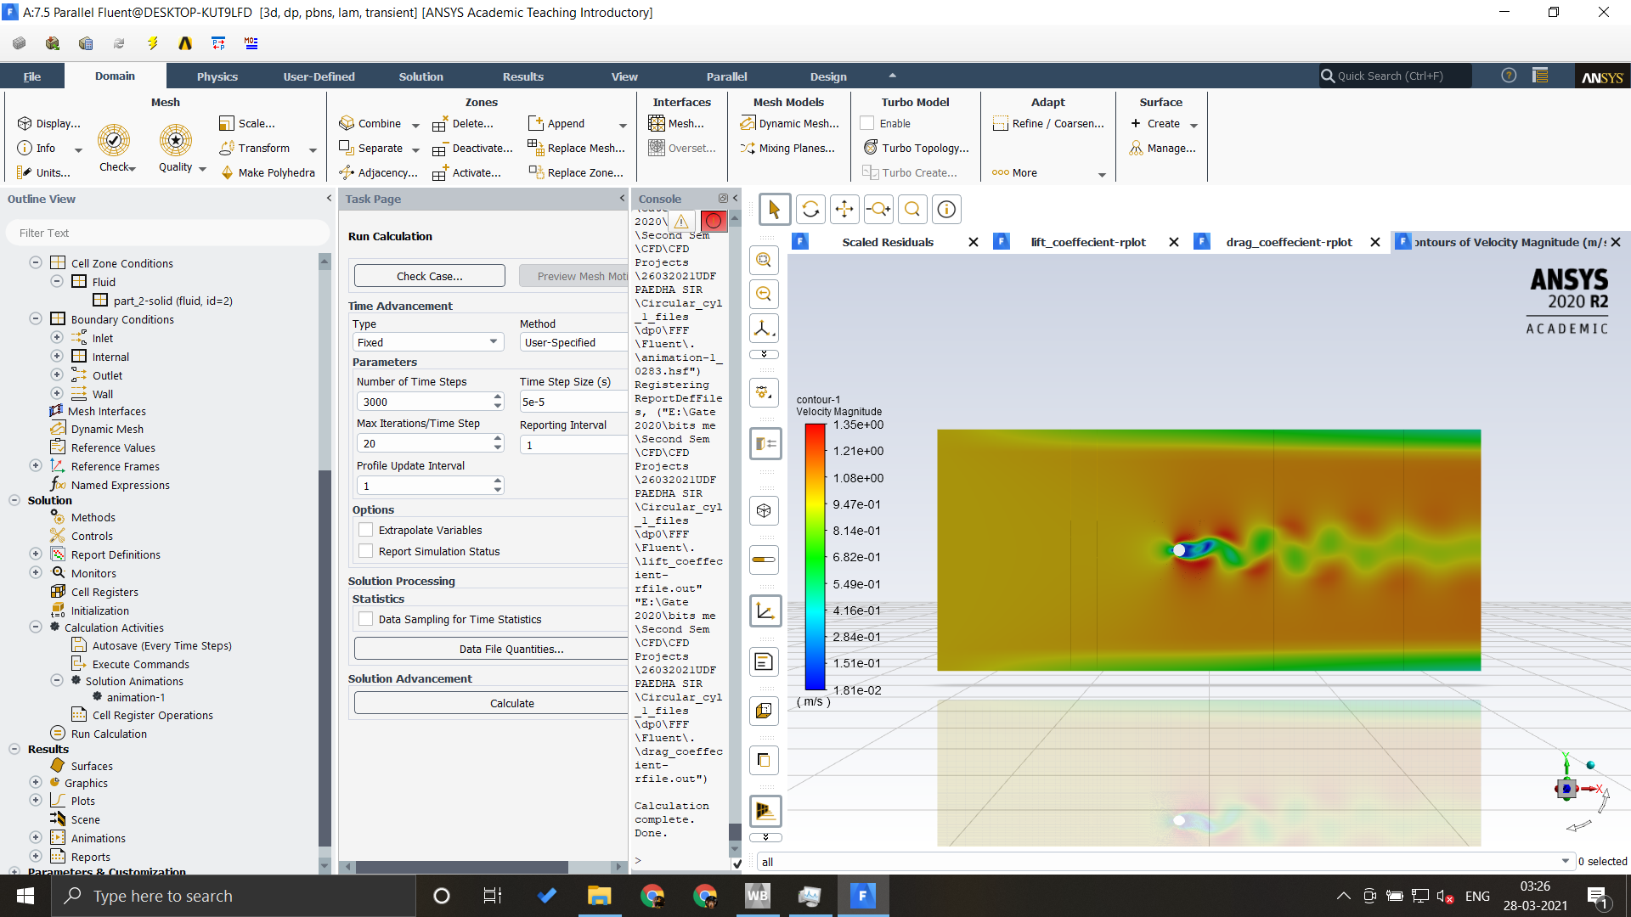
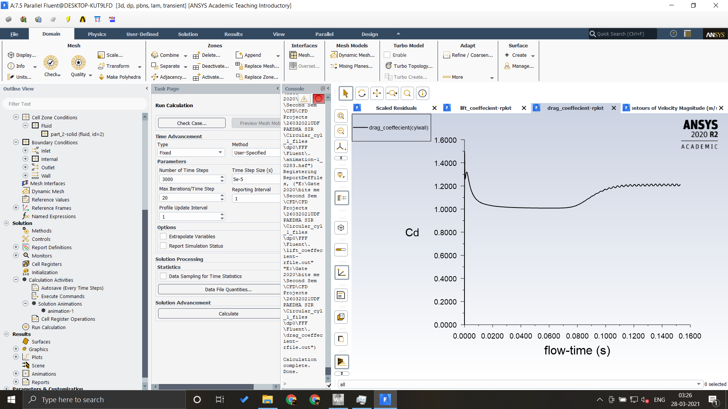
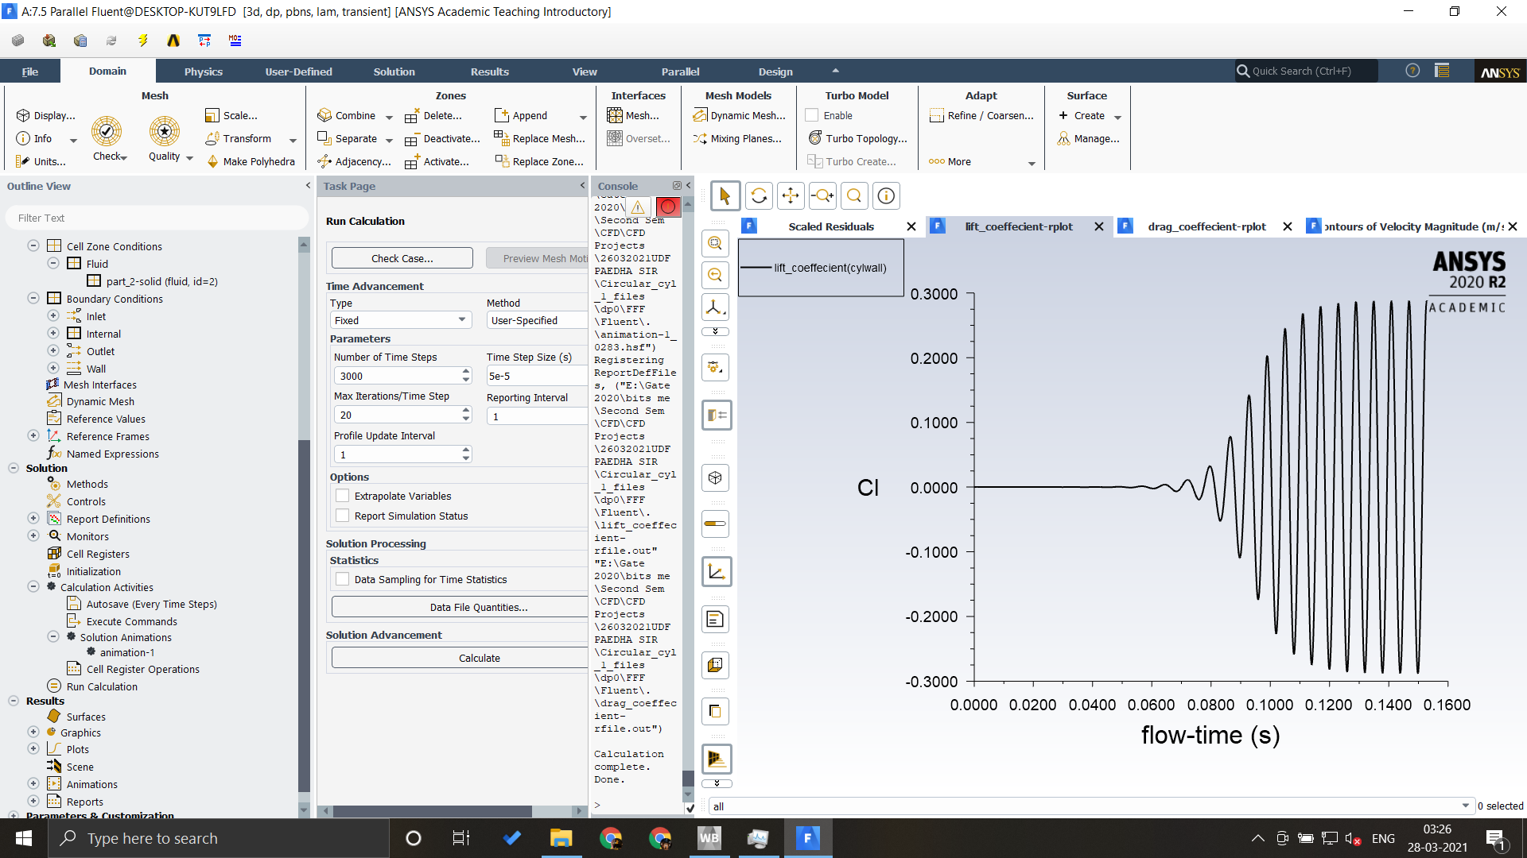
Case 3: Domain thickness 20mm and Free Stream at top & bottom plates

Slide 6
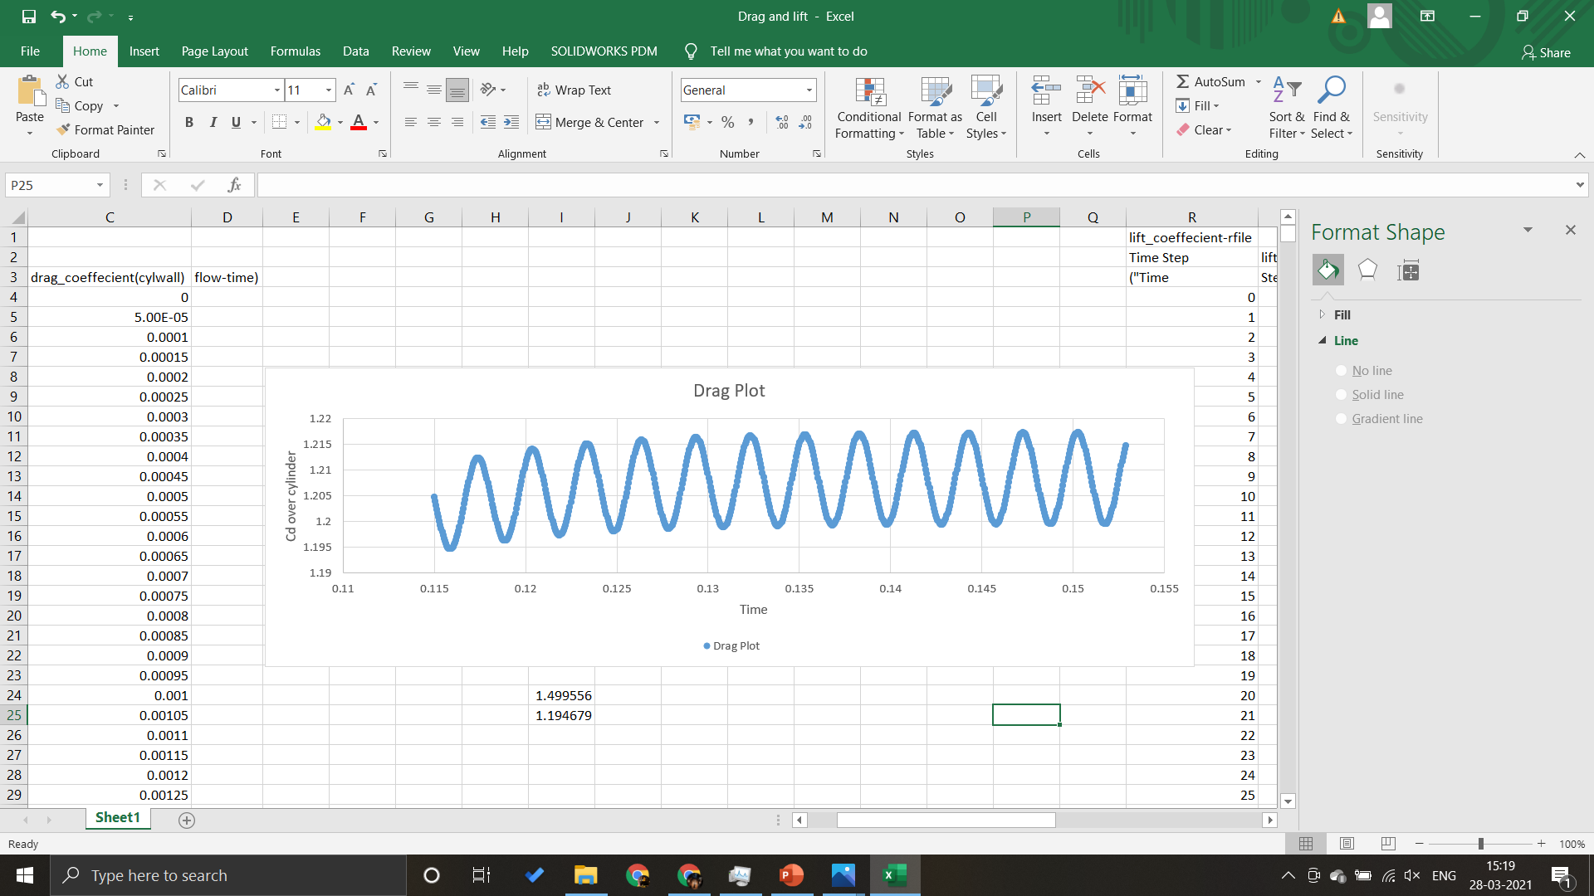
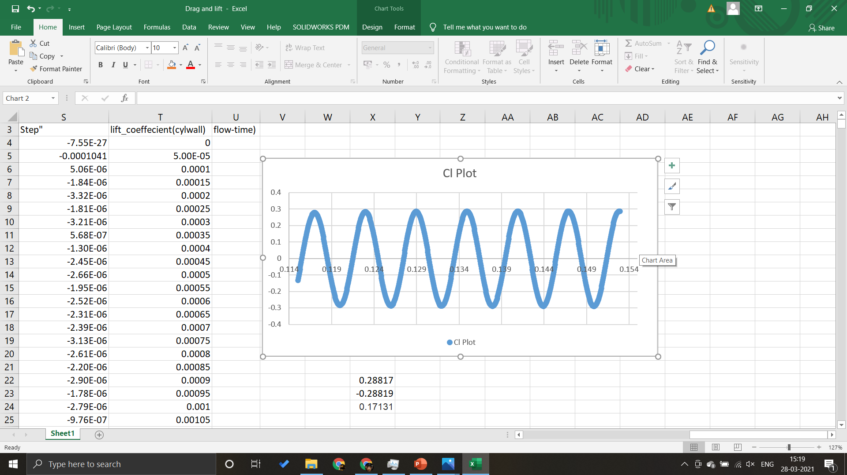
Extracted DATA:
Cd max →1.499
Cd min → 1.194
Cl max →0.288
Cl min → -0.288
Cl rms → 0.171

Slide 7
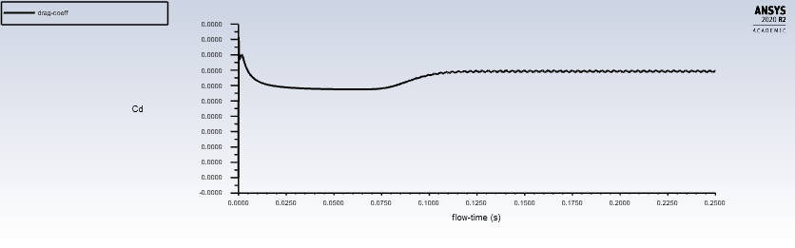
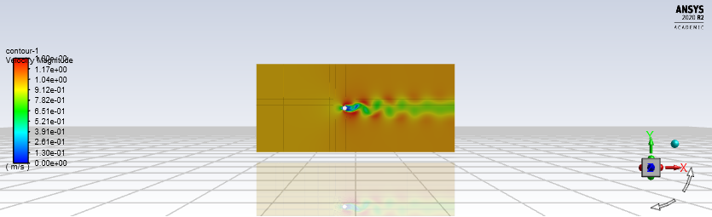
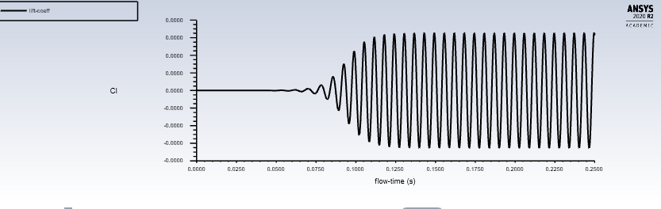
Case 4 : Domain thickness 20mm and No Slip at top & bottom plates

Slide 8
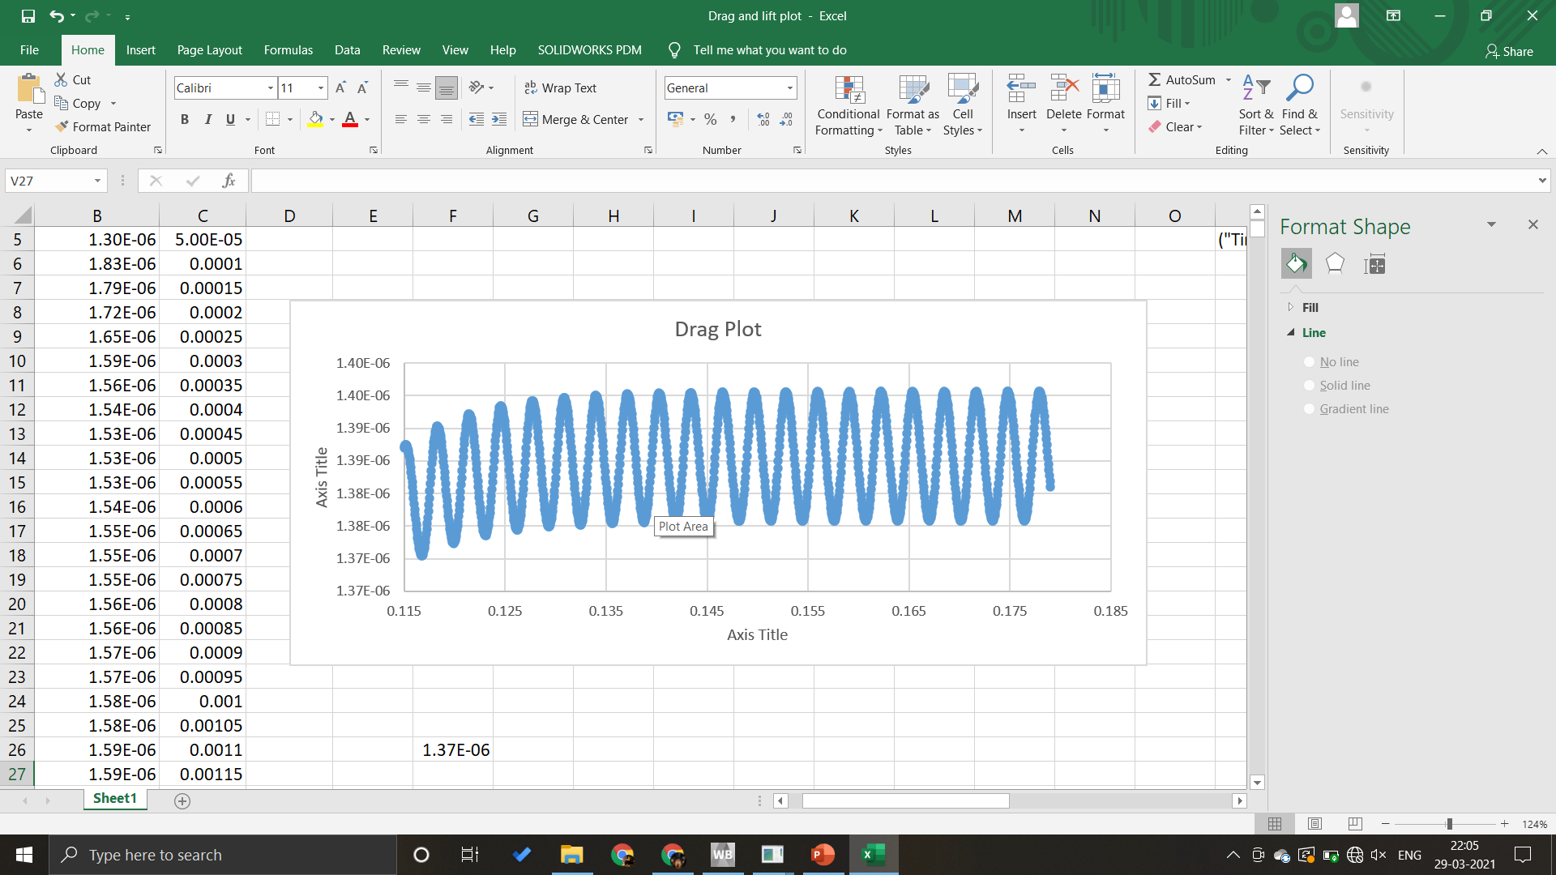
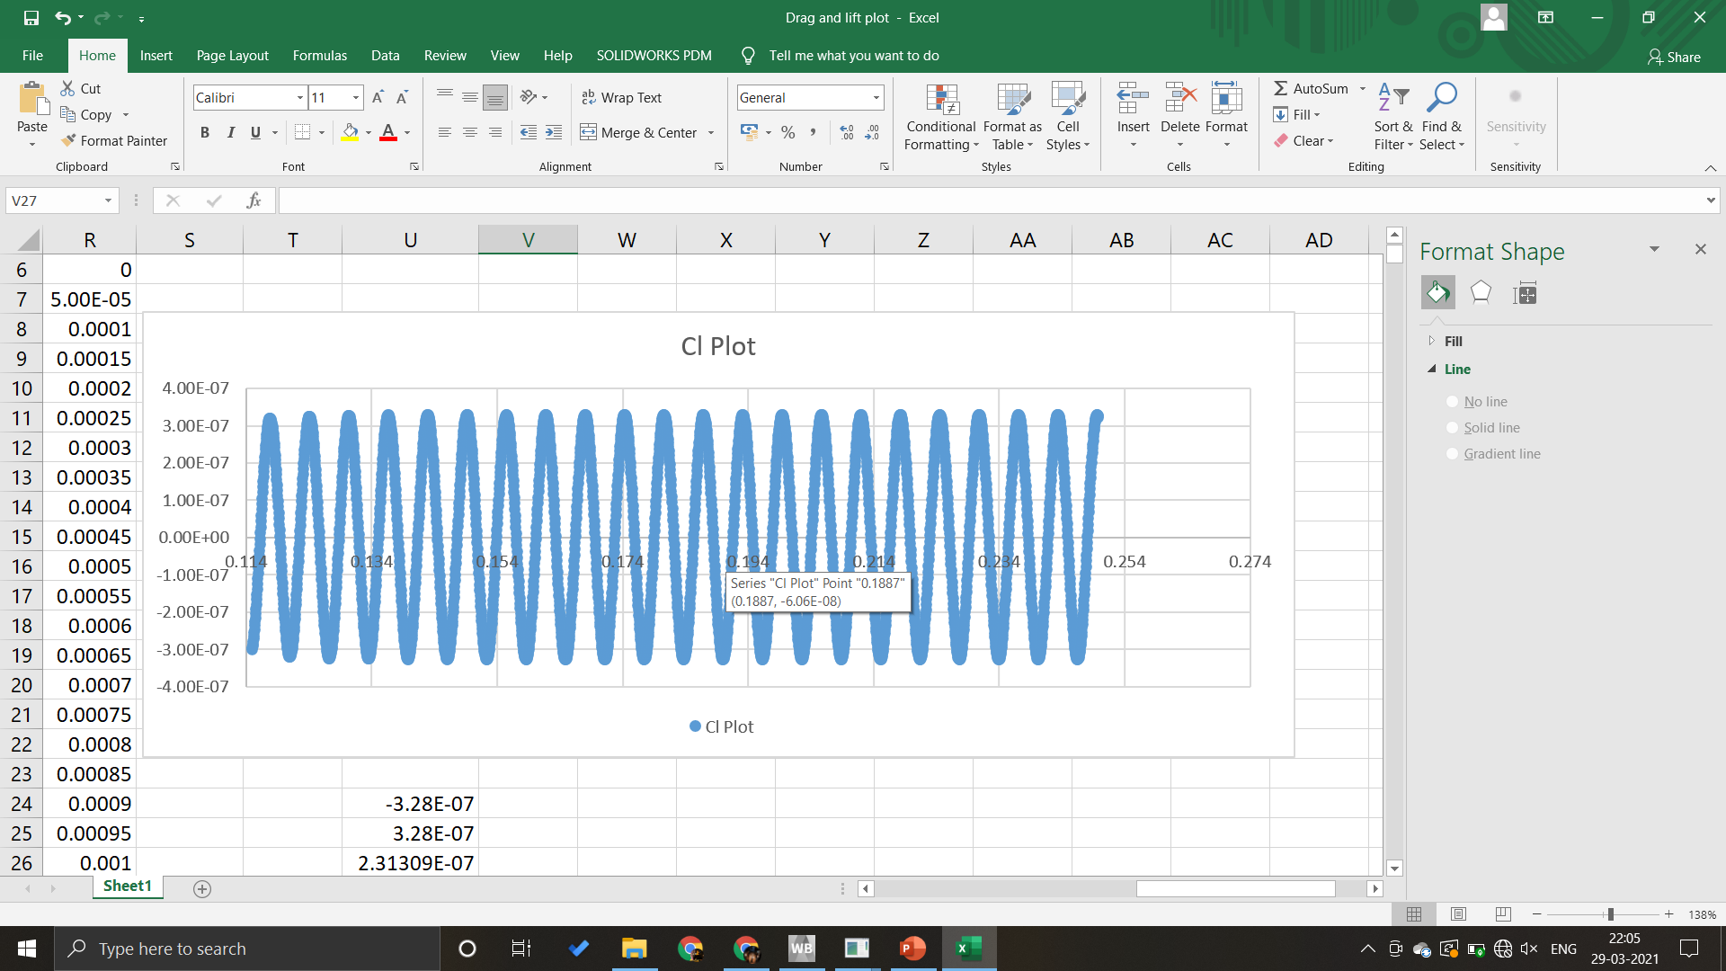
Extracted DATA:
Cd max → 1.42
Cd min → 1.38
Cl max → 0.328
Cl min → -0.328
Cl rms → 0.231

Slide 9
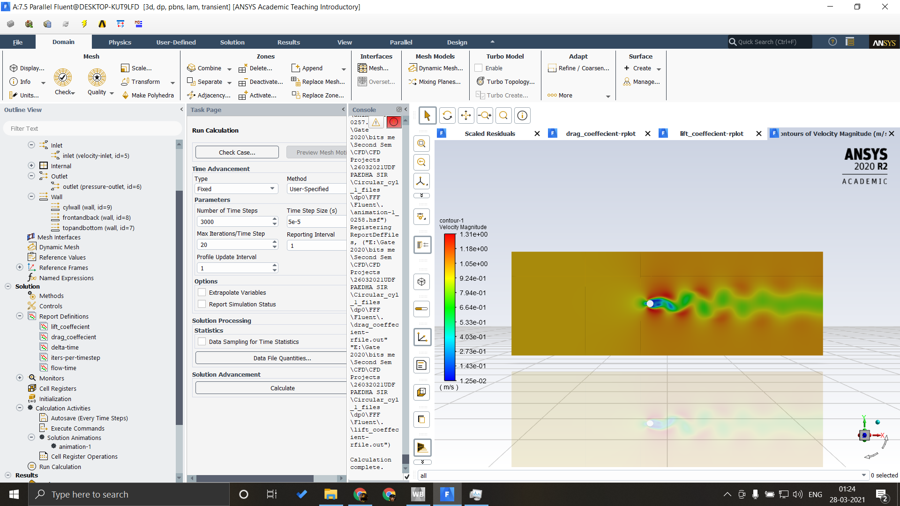
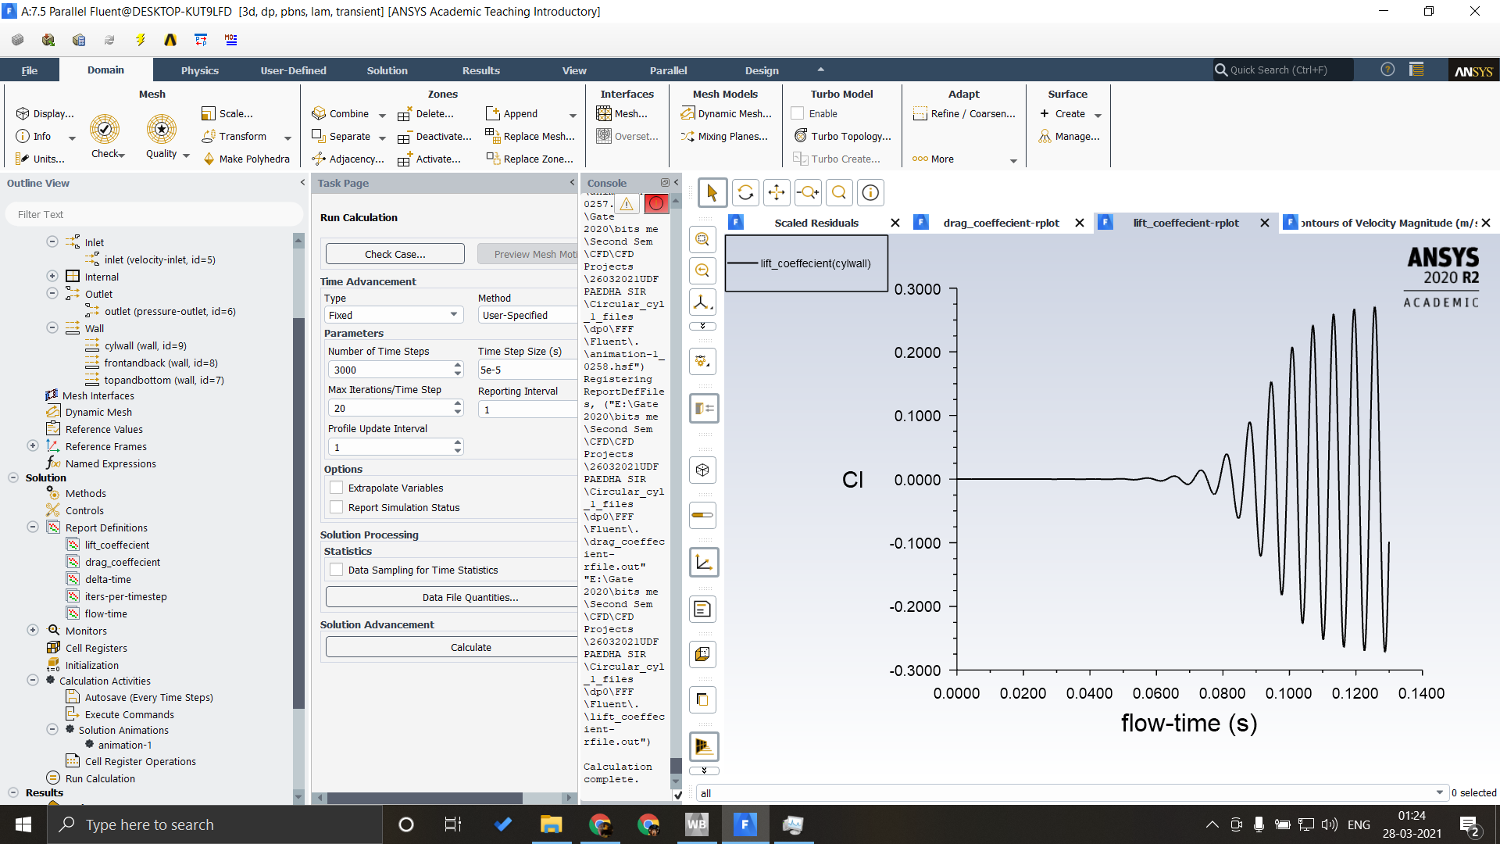
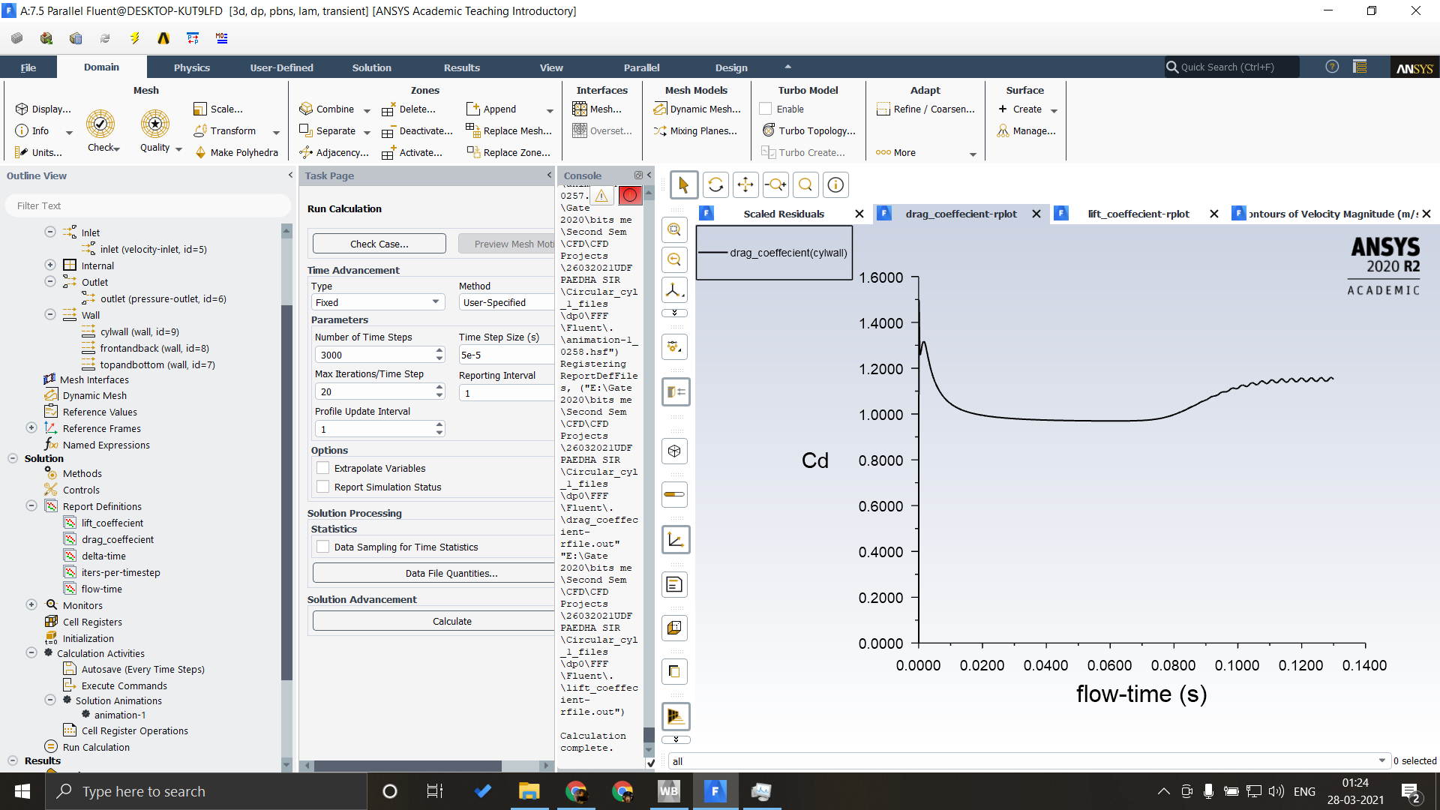
Case 5 : Domain thickness 15mm and No Shear at top & bottom plates

Slide 10
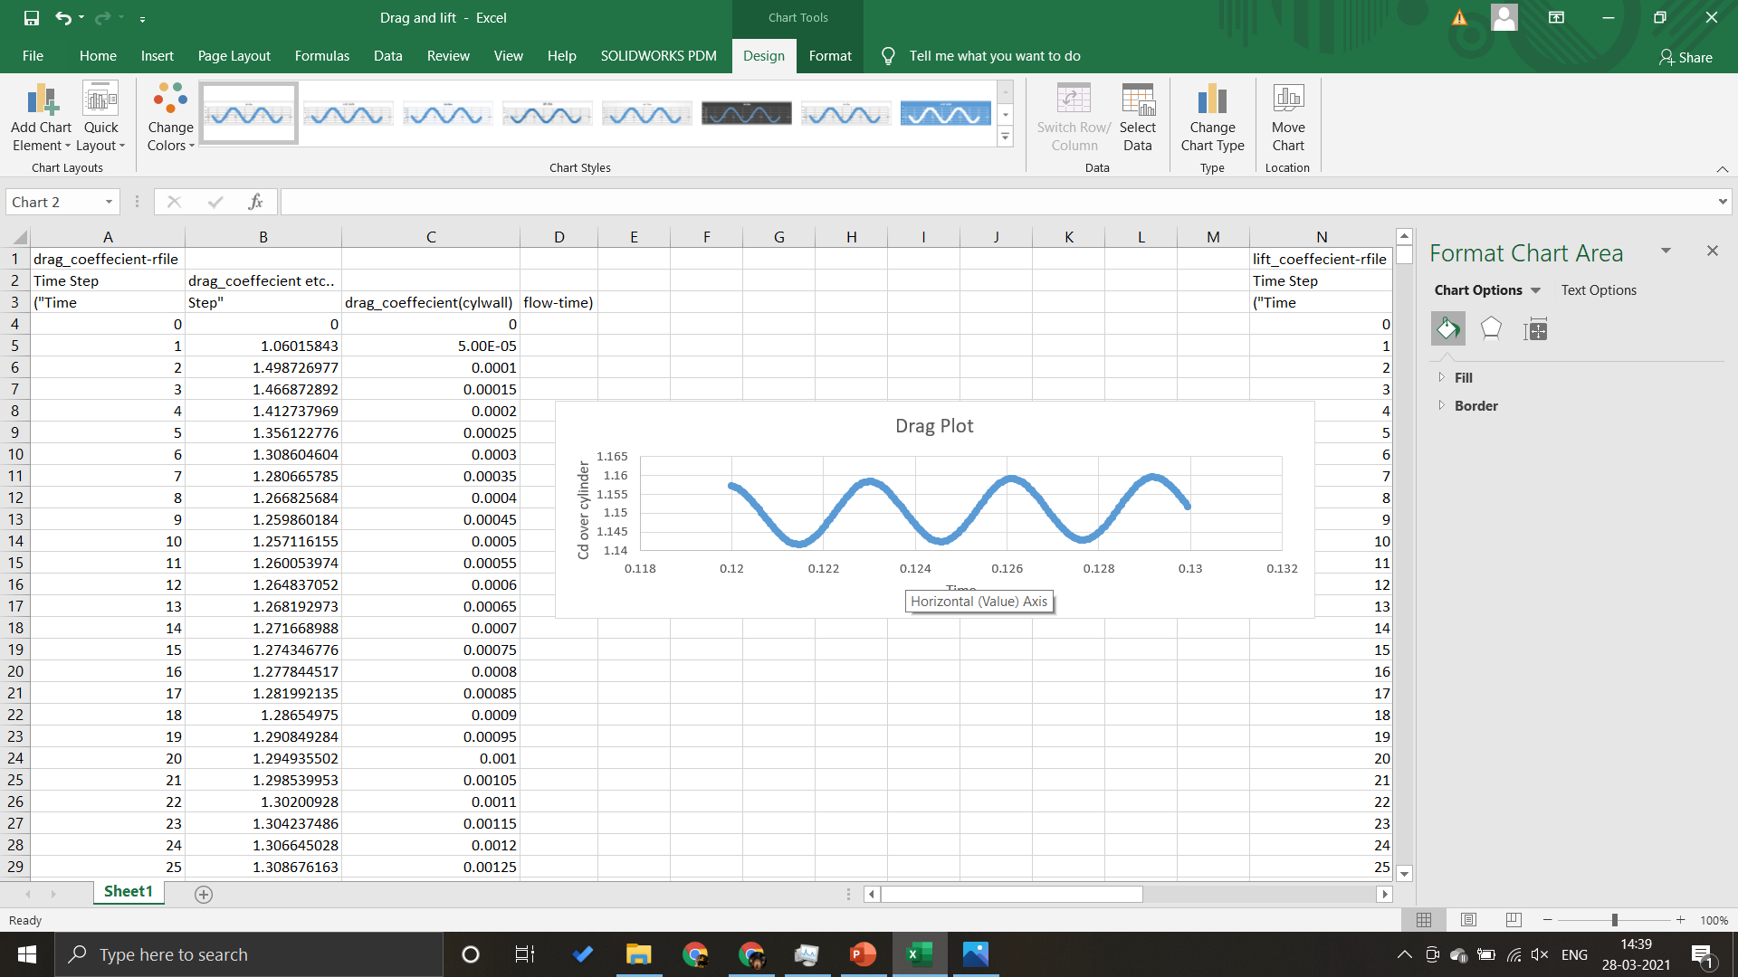
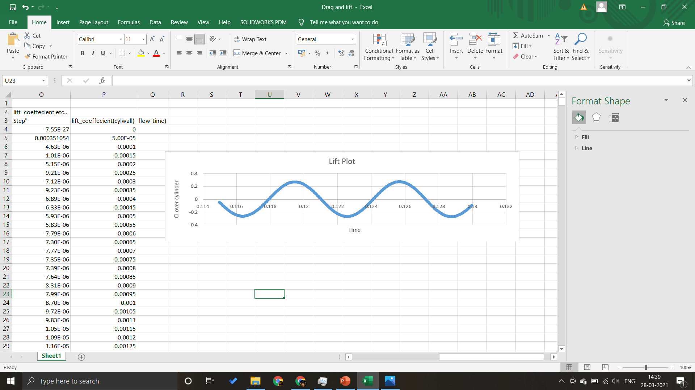
Extracted DATA:
Cd max → 1.16
Cd min → 1.14
Cl max → 0.22
Cl min → -0.22
Cl rms → 0.193131

Slide 11
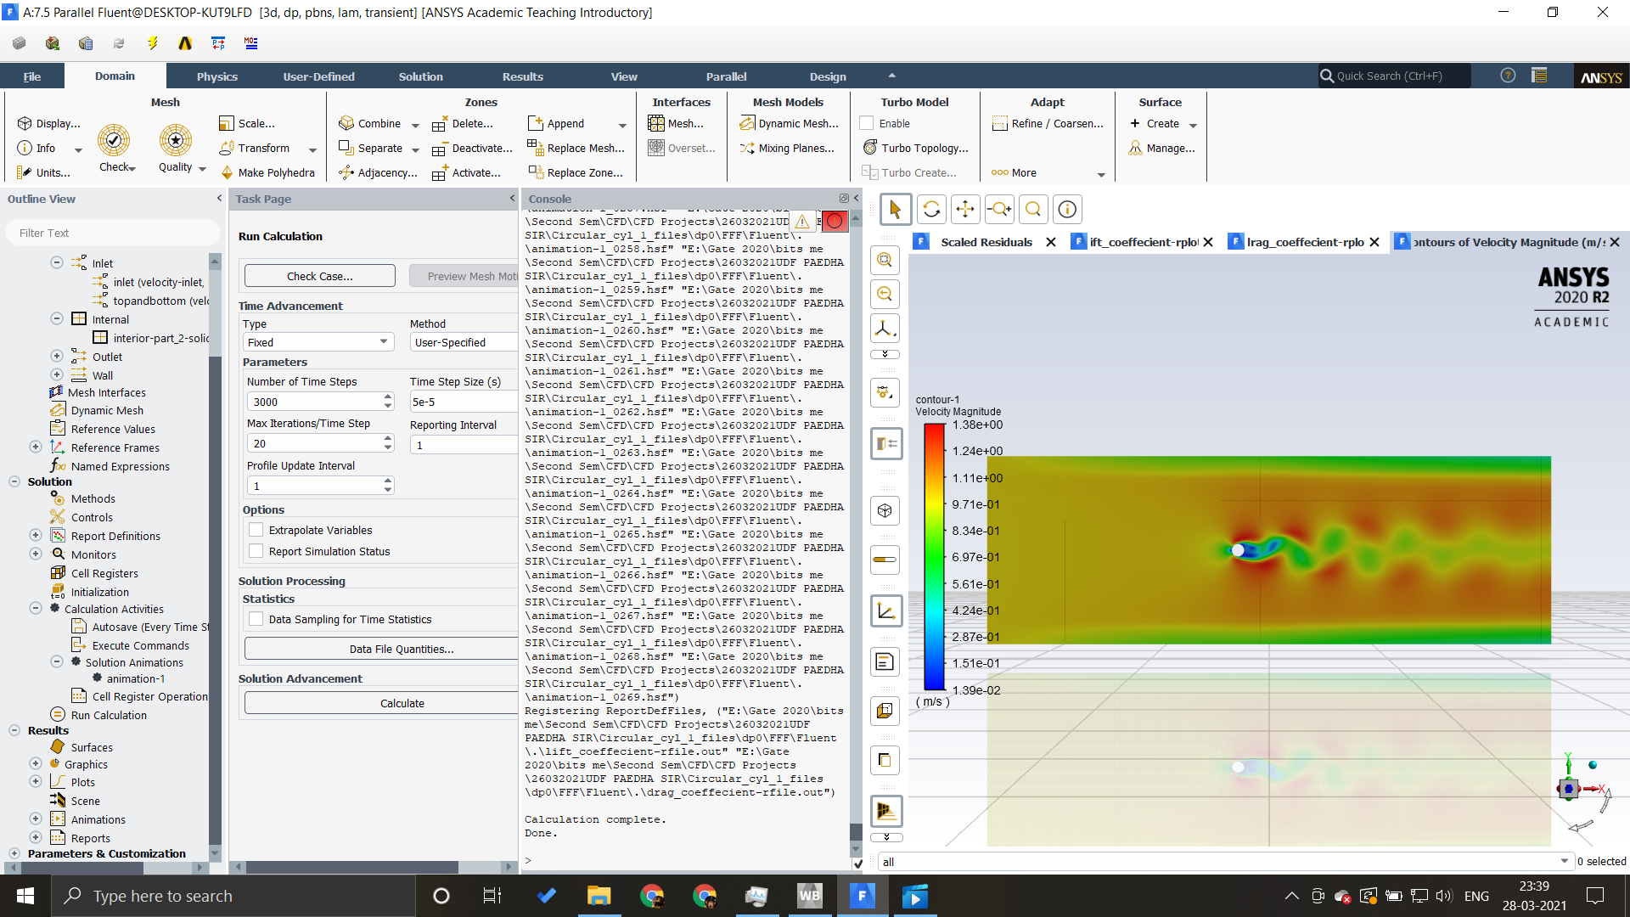
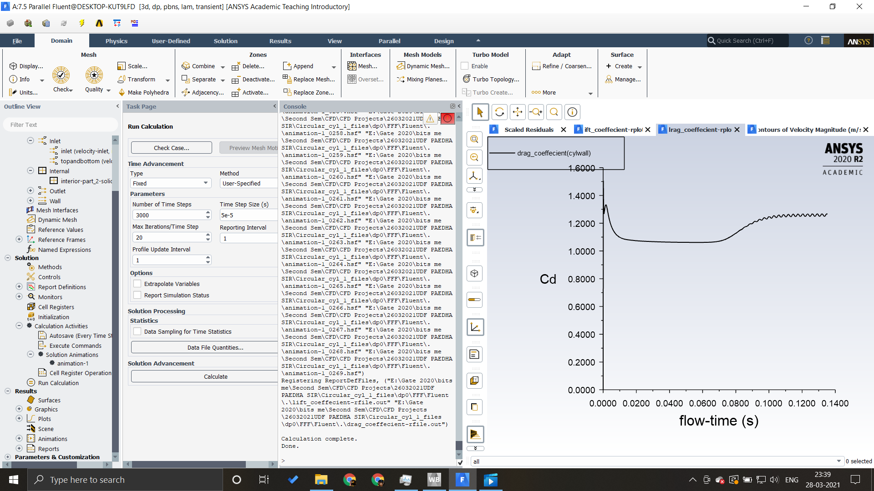
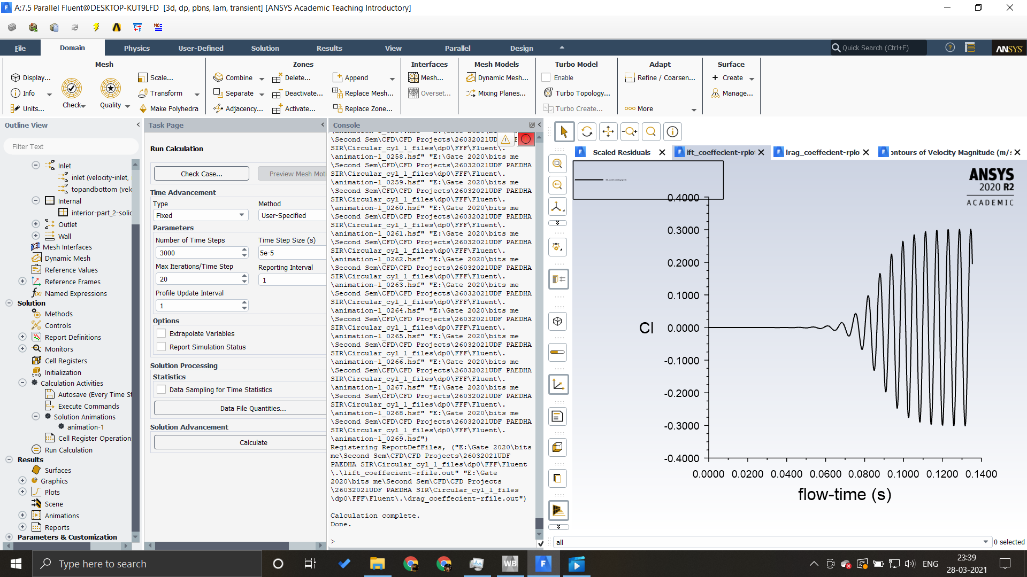
Case 6 : Domain thickness 15mm and Free Stream at top & bottom plates

Slide 12
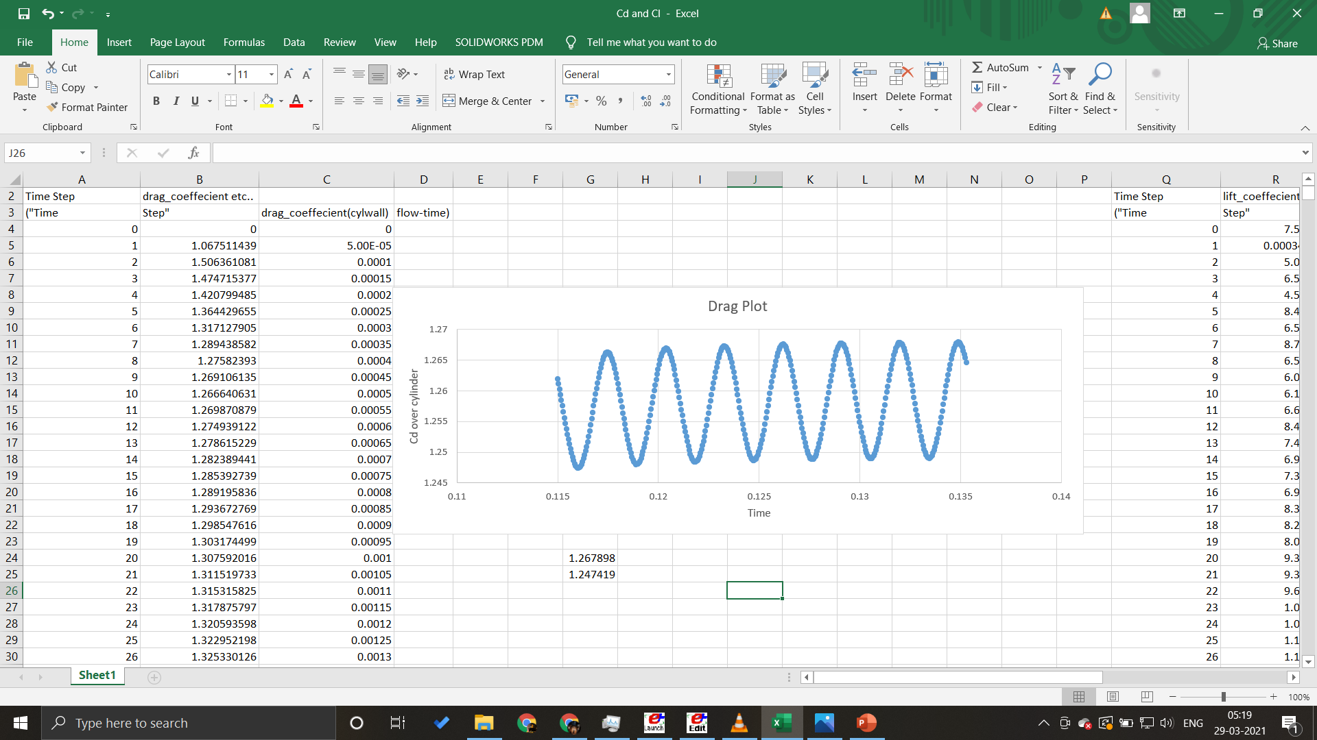
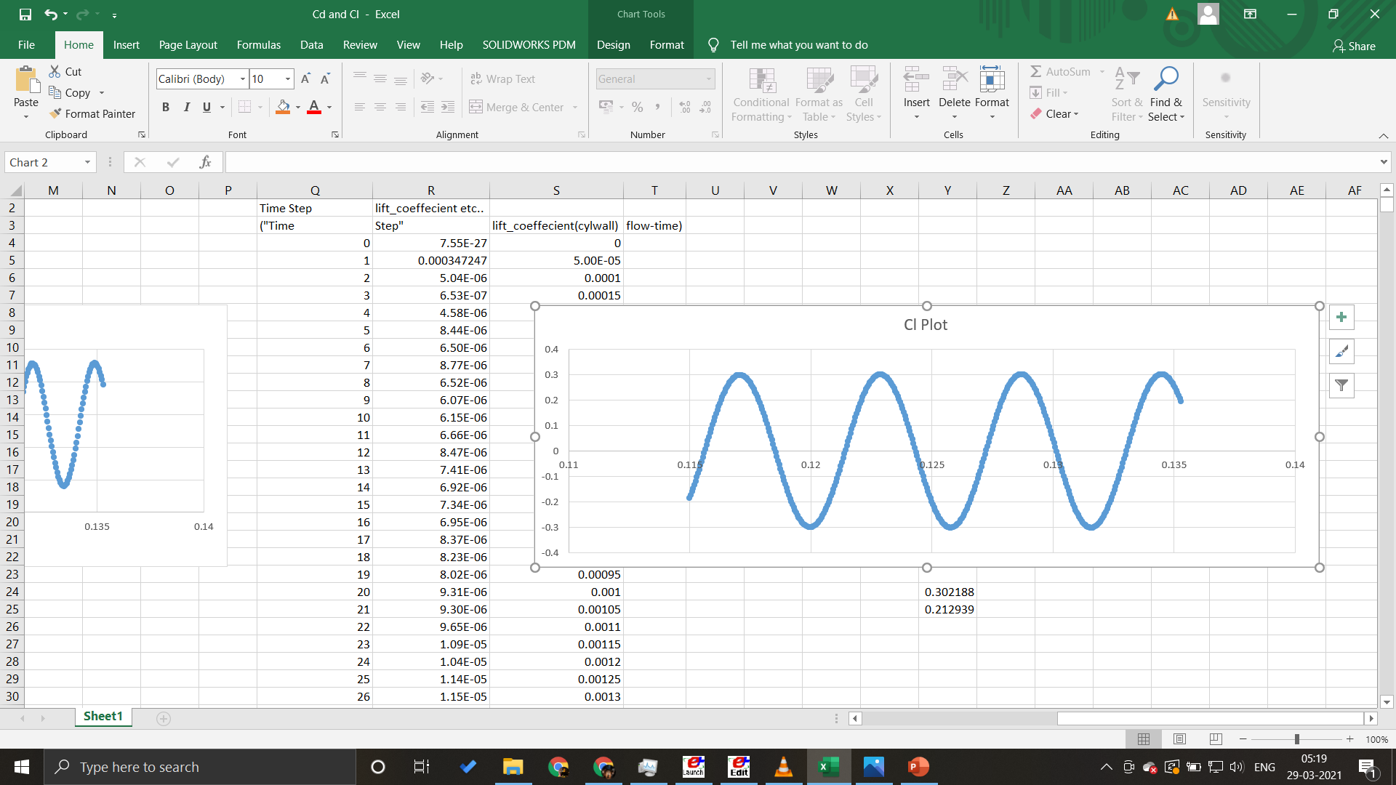
Extracted DATA:
Cd max → 1.267
Cd min → 1.247
Cl max → 0.302
Cl rms → 0.212

Slide 13
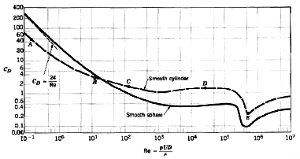
Conclusion:
As we decrease the domain size we start getting incorrect results as compared to the experimental data that we already have available on the internet.

Slide 14
Free Stream Boundary Condition:
But comparing free stream boundary condition from No Shear we can say that
Free stream Cd value is a little lesser than Cd value in no shear boundary condition.
I think this happens because the free stream velocity boundary condition given at top and bottom helps the fluid to stay laminar at top of cylinder and thus giving it a lesser coefficient of drag.

